Slide 1
Lexical Conceptual Mapping
Barbora Mahdalová, Lea K. Komárková
Palacký University Olomouc
March 4, 2026

Slide 2
•
Goal: Connect Lexical Units (surface words) and Conceptual Schemas (abstract thought).
•
Method: Using WordNet and ChainNet to extract semantic hierarchies and identify cognitive mechanisms.
•
Outcome: A structured data pipeline capable of identifying metaphors and metonymies from raw text.

Slide 3

WHAT WE ARE WORKING WITH
Metonymy (Contiguity)
Metaphor (Similarity)
A mapping across different domains.
A conceptual shift within the same domain.
Example: "The White House issued a statement."
Example: "Time is Money."
Mapping: [Building] → [Institution]
Mapping: [Source: Finance] → [Target: Temporal]
LCM's Goal: To teach Python to recognize these shifts automatically by mapping Words to Conceptual Schemas.

Slide 4
Climbing the Semantic Tree
To understand a concept, the code doesn't just look at the word. It looks at its ancestors(hypernyms).
Example: "Crossroads"
→ Crisis situation
→ Unstable situation
→ State/Condition
→ Concept: LIFE IS A JOURNEY
Dollar → Currency → Medium of Exchange → Money → Asset

Slide 5
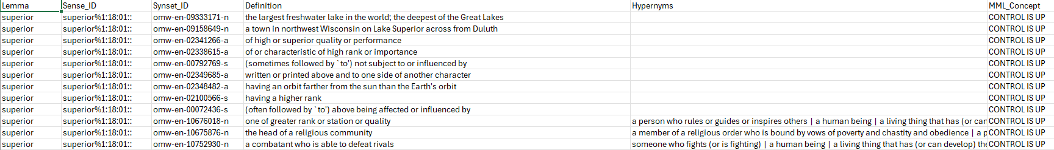
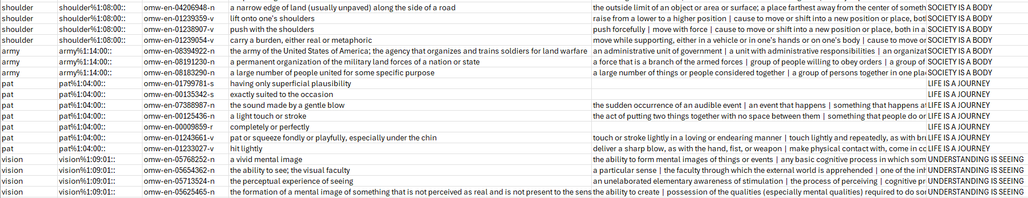
Results: Mapping Examples

Slide 6
Problems and how we solved them
•
The output CSV did not contain the hypernyms corresponding to the mapped synsets.
•
Some mappings between ChainNet metonymy/metaphor relations and WordNet synsets were incorrect or incomplete.

Slide 7
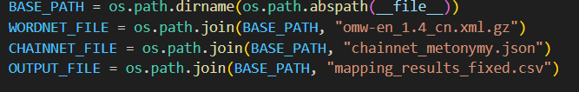
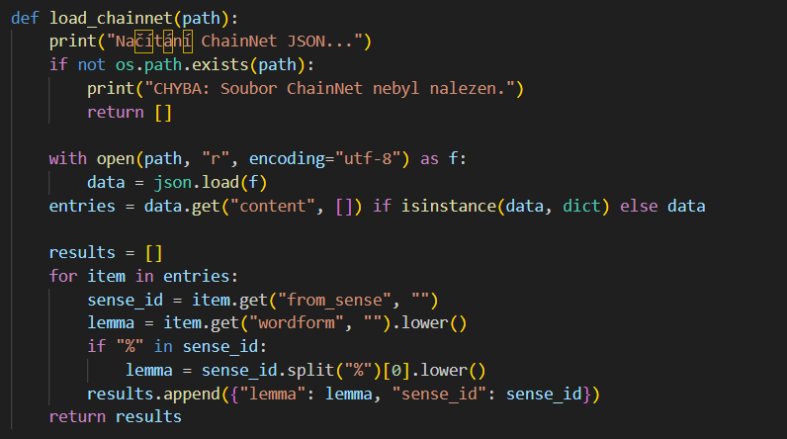

Slide 8
Thank you for your attention.
Questions?

